Slide 1
Basics of IP Addressing
Dr.Mohammed Abdalla Mahmoud Youssif
1

Slide 2
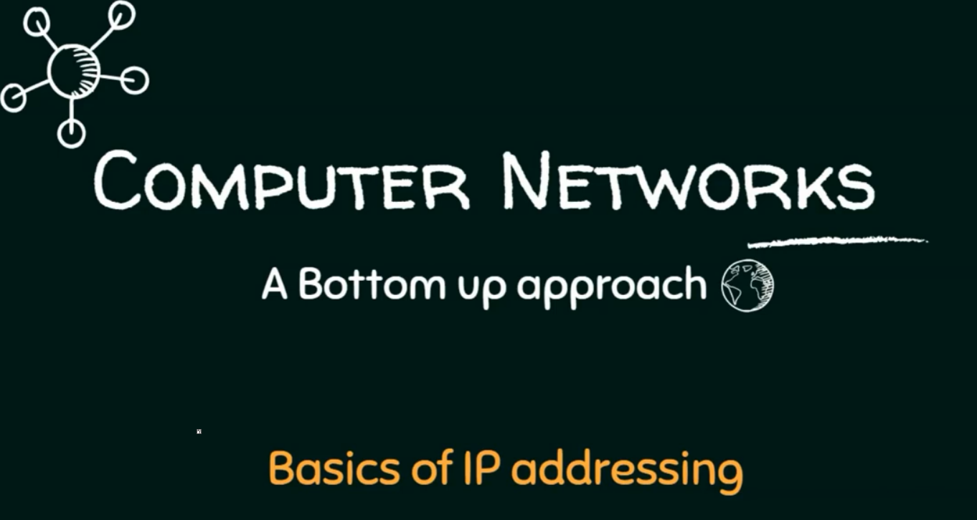
2
Notes:
2

Slide 3
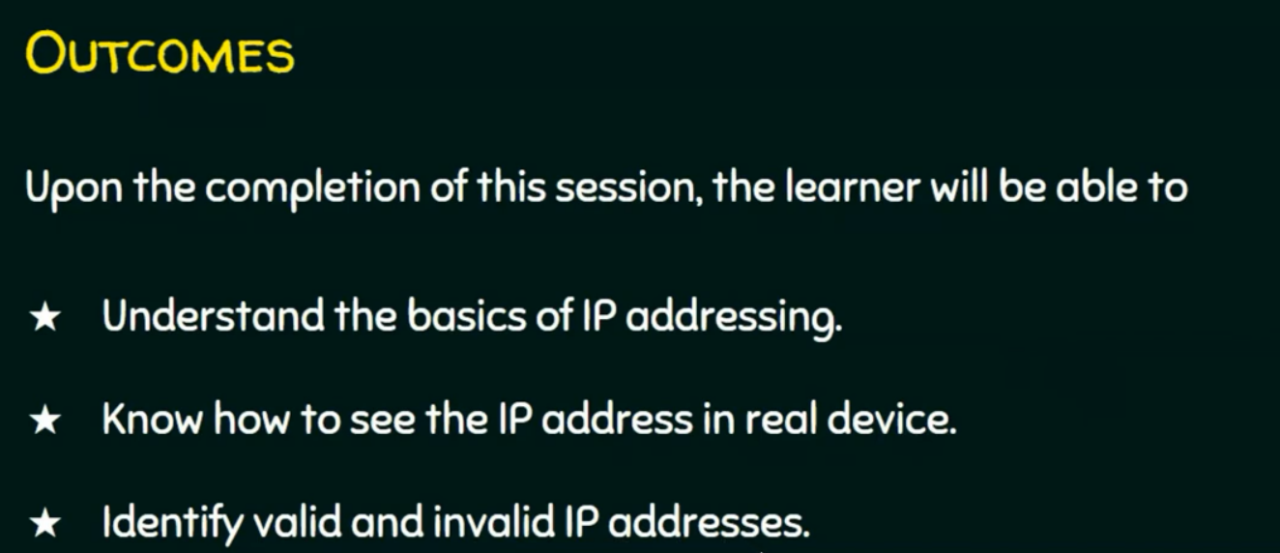
3
Notes:
3

Slide 4
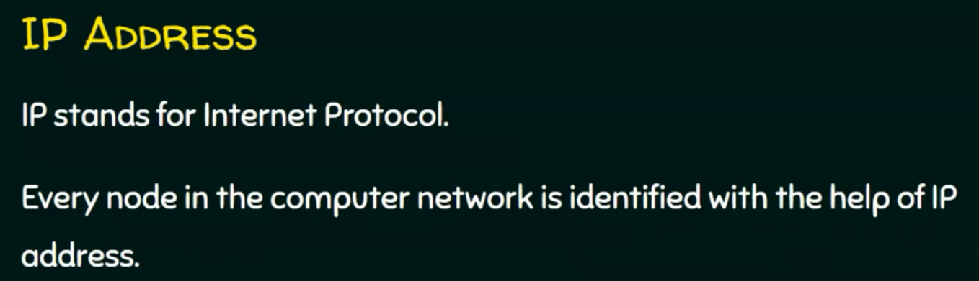
4
Notes:
4

Slide 5
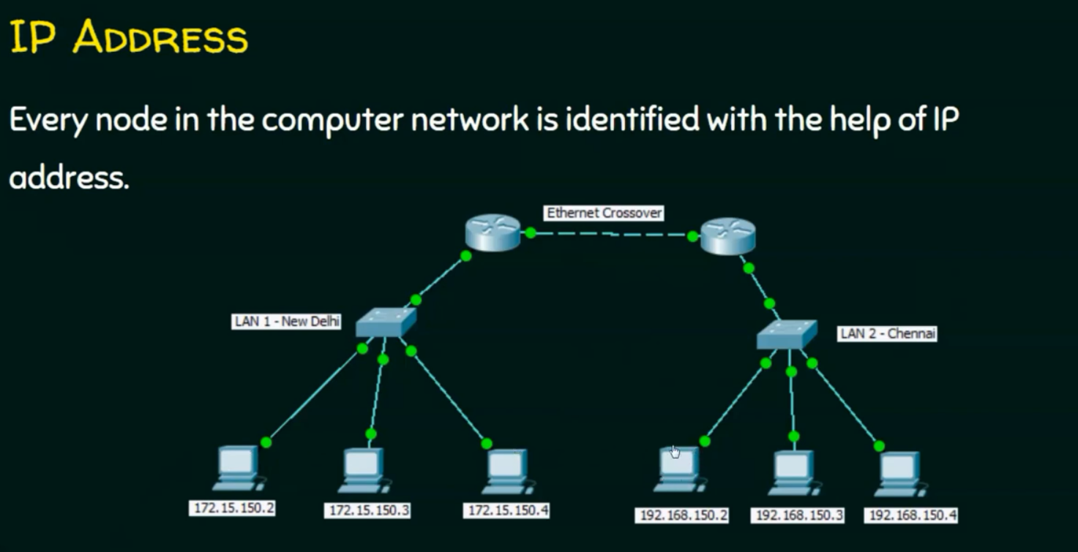
5
Notes:
5

Slide 6
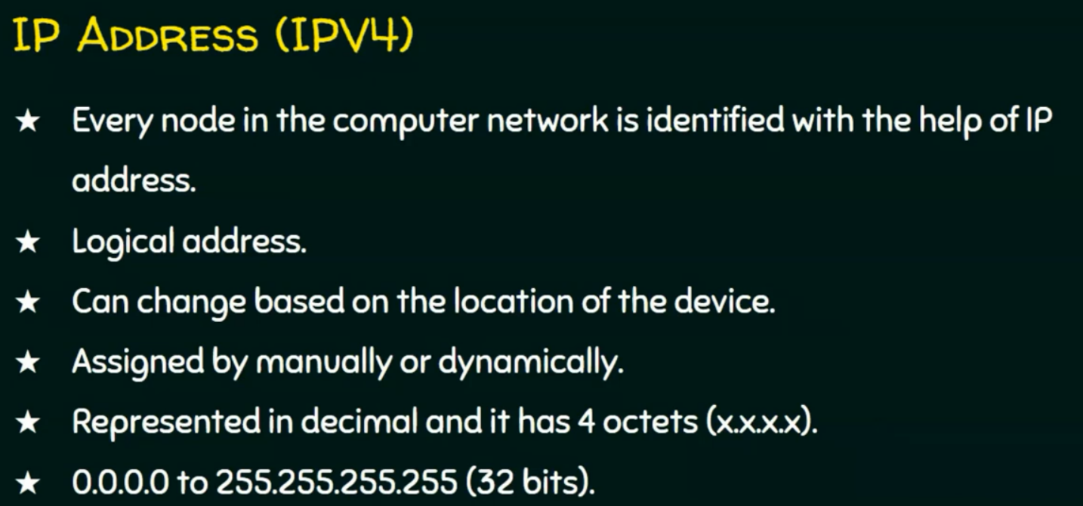
6
Notes:
6

Slide 7
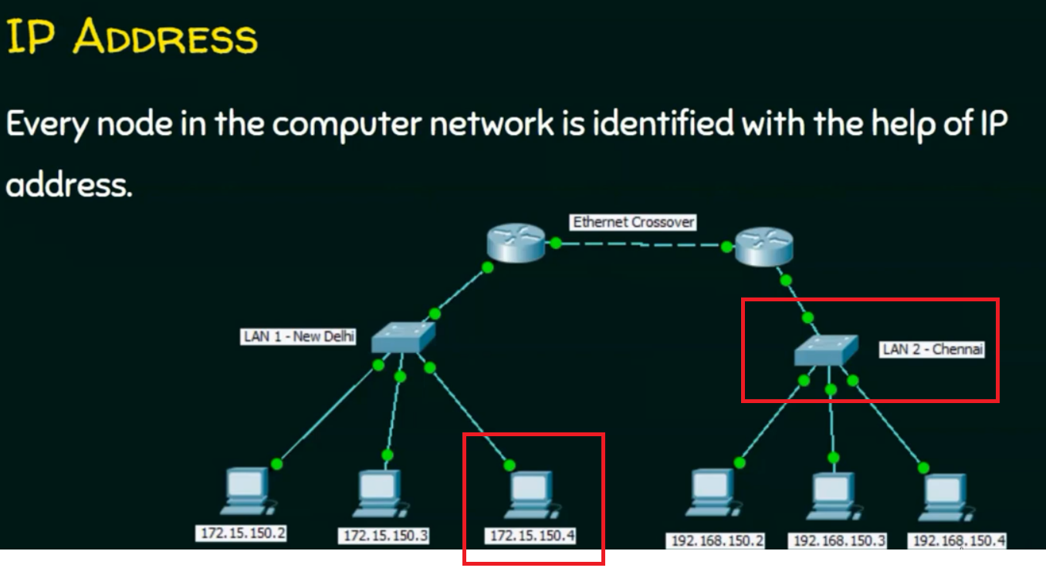
7
Notes:
why it named as logical address?
Suppose you need to move node with ip 172.15.150.4 to lan2 , so this ip must be changed to be included in the range of the second lan so ip can be 192.168.150.5, so the ip is changed based on the logic of the location.
7

Slide 8
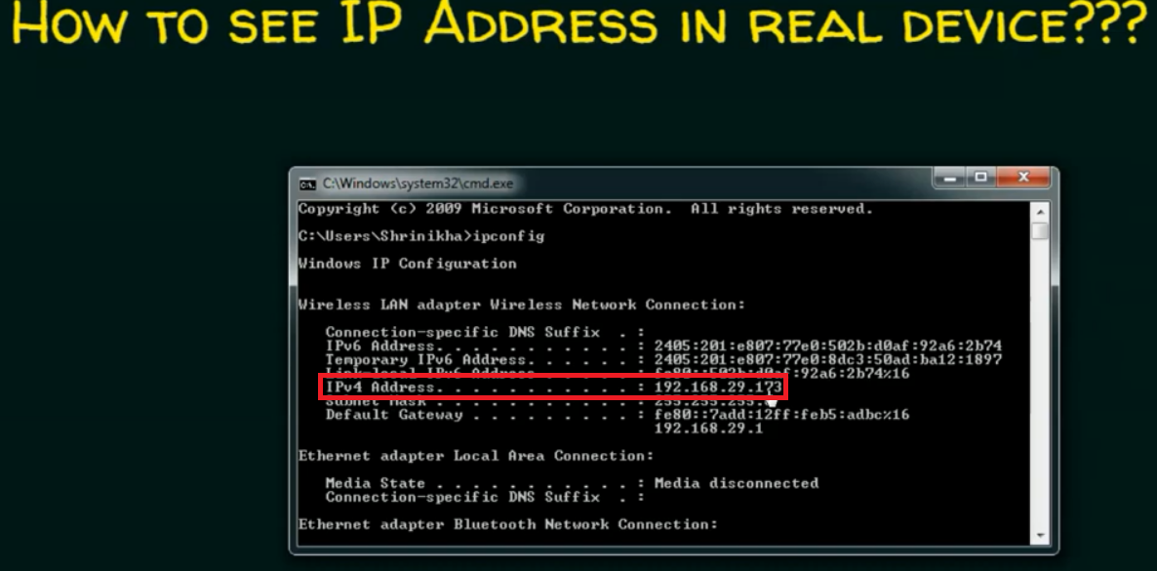
8
Notes:
8

Slide 9
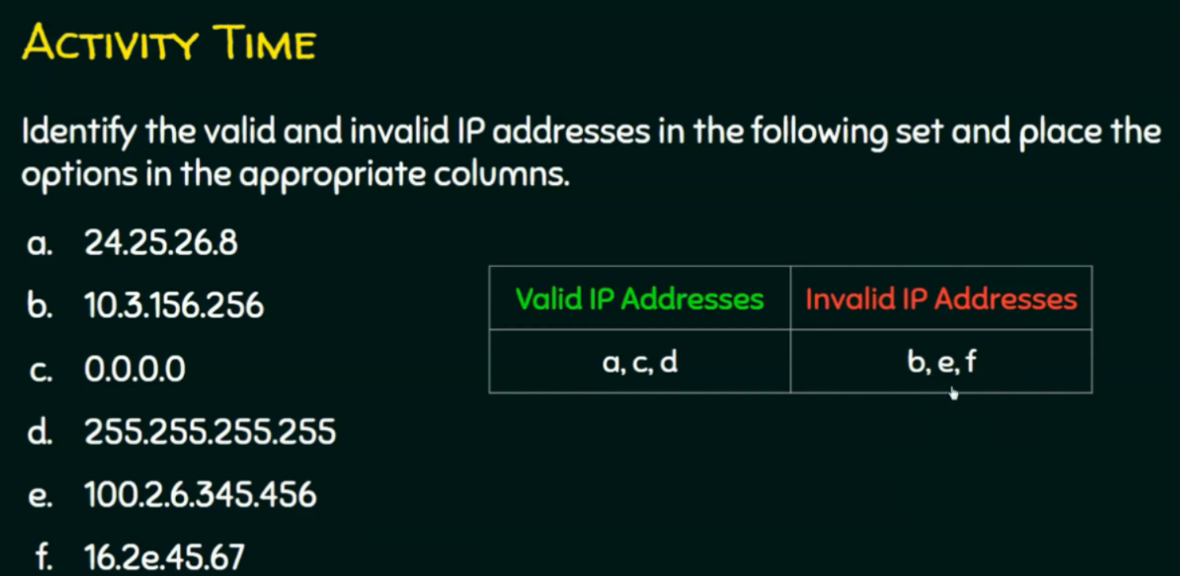
9
Notes:
10.3.156.256 → is not a valid entry because 256 is out of the range.
100.2.6.345.456 is not valid entry because it is 5 optics. And out of range also. Not valid for 2 reasons.
16.2e.45.67 is not valid because is decimal.
9

Slide 10
Questions ?
10
Notes:
10

